Slide 1
Redesigning work: workflows, value and the business case (practical)
Which tasks change, what is it worth, and when does it pay back?
Leading with AI | Session 11 of the 15 (Sessions 0 to 14)
KLAi Professional Learning | Jotham Martin Wambi
Notes:
Welcome to Session 11, the first of four practical sessions. In Session 10 we decided what an AI agent may do on its own: its keys, its level of freedom, and human approval before anything that cannot be undone. Today the mode changes. For ten sessions I mostly showed and you watched.
From today you do most of the work, on your own organisation, and I work beside you. We take one task your team repeats, map it, choose the right help for each step, and put a value on it in shillings. Our question is the one your board will ask: which tasks change, what is it worth, and when does it pay back?

Slide 2



Today in one view: what you will leave with
By the end of today you will have
A map of one workflow of your own, with a choice for every step: a rule, an AI step, an agent or a person
A business case in shillings for one change: time saved, errors avoided, the payback period and the first-year return
Your AI Opportunity Portfolio scored on value and feasibility, with the entry to start first
Notes:
You answer that question for your own work, and you leave with three things made by your own hand. A map of one workflow, with a choice for every step: a rule, an AI step, an agent or a person. A business case in shillings for one change: the time saved, the errors avoided, the payback period and the first-year return.
And your AI Opportunity Portfolio, scored on value and feasibility, with the entry to start first. The clock shows how much of today is yours.

Slide 3
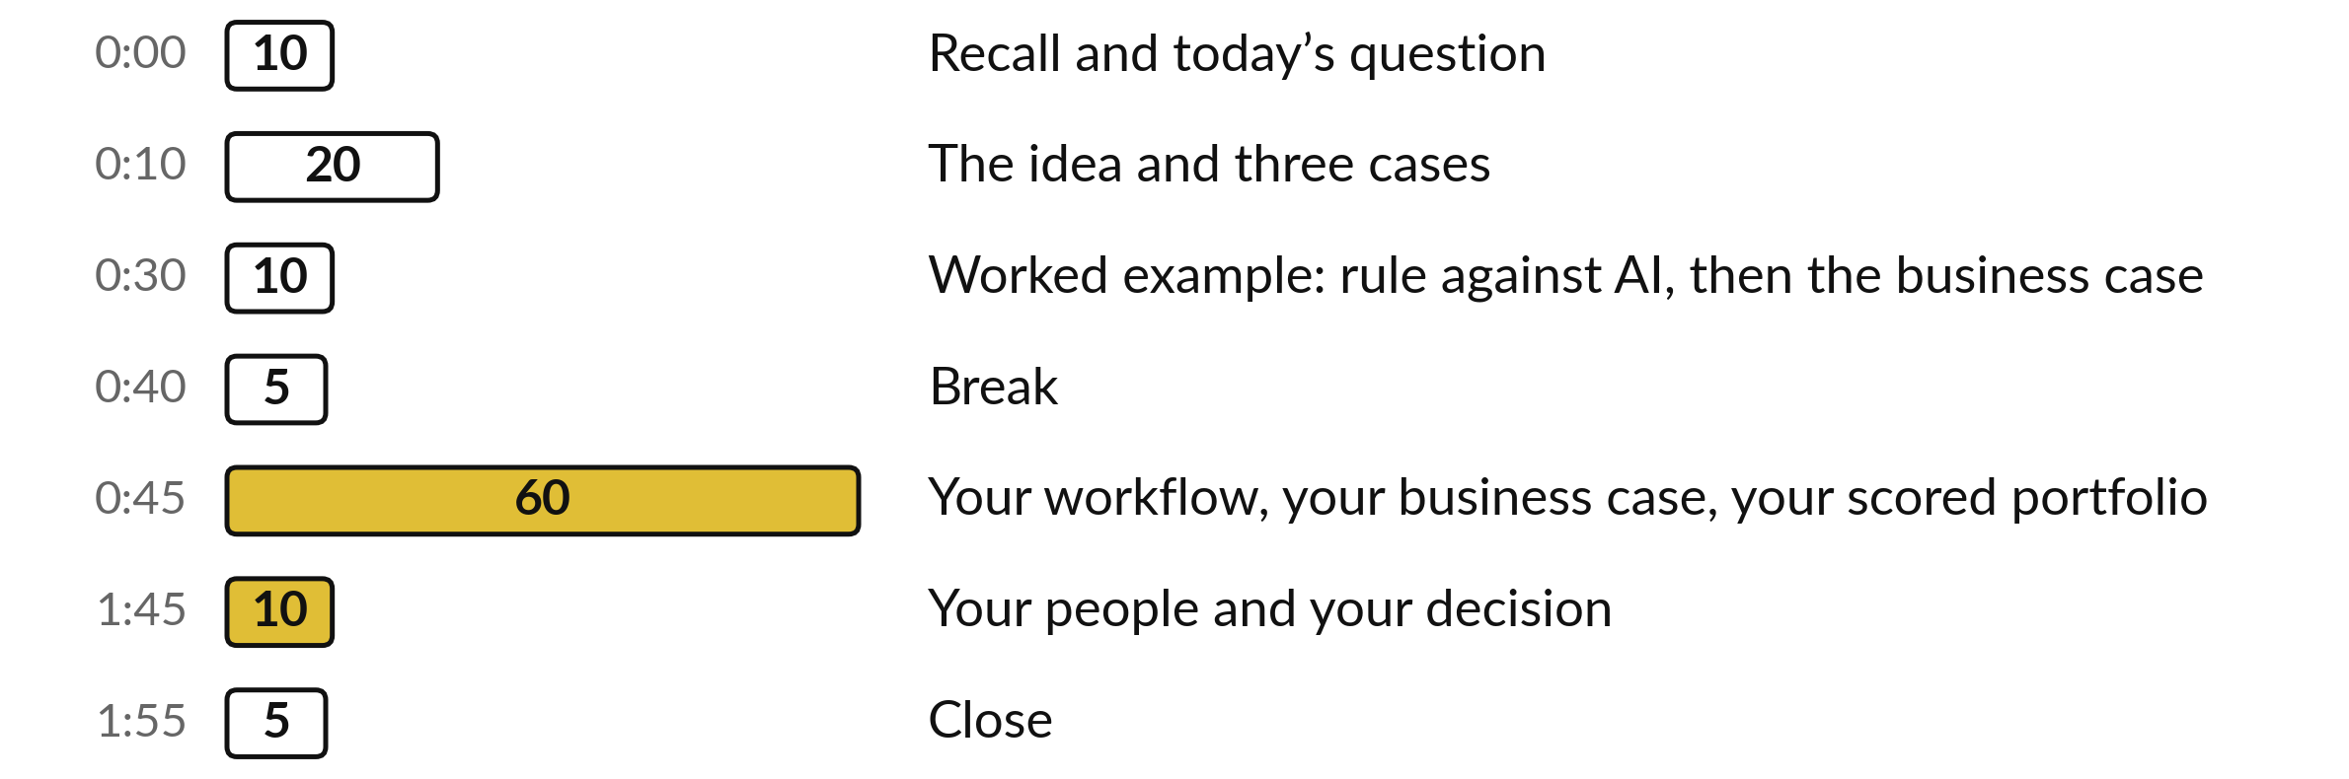
Your two hours: sixty minutes are
your own workflow and business case
Most of today is your own work, with me at your side.
Notes:
This is a practical, and the clock shows it. Ten minutes to recall Session 10 and see why today’s question matters. Twenty minutes on the idea: a workflow and its map, four kinds of help, three kinds of value and three real cases. Ten minutes on a worked example: a rule against AI on twelve messages, then a business case in shillings.
A five-minute break. Then sixty minutes on your own workflow, business case and portfolio. Ten minutes on your people and your decision, and five to close.

Slide 4

Three questions from last time
1. What turns a chatbot into an agent?
2. Which four kinds of action always wait for a person?
3. What are the five levels of freedom, and which do you choose?
Answer aloud first. Then we check together.
Notes:
Three quick questions from Session 10. Answer aloud first, and then we check together. It is a warm-up to bring last time back.
Question one. What turns a chatbot into an agent? Take a moment.
A good answer is this. Tools, so it can act, and a loop, so it chooses its own next step: plan, act, check, repeat.
Question two. Which four kinds of action always wait for a person? Say it to yourself first.
A good answer is this. Sends, payments, deletions, and commitments such as accepting a price.
Question three. What are the five levels of freedom, and which do you choose? Think about your own work as you answer.
A good answer is this. Answers, suggests, drafts with approval, acts then reports, acts alone. Choose the lowest level that does the job.
If an answer was missing, last session’s take-away sheet or workbook page has it. Now to today.

Slide 5
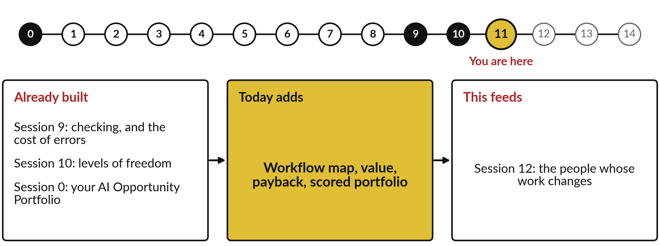
How today connects: what we
already have and what it feeds
Each session is built on the ones before it.
Notes:
So where does today sit in the story? The dots along the top are the fifteen sessions, from the map at Session 0 to your plan at Session 14, and the gold one is today.
We already hold checking, and the cost of errors from Session 9, levels of freedom from Session 10 and your AI Opportunity Portfolio from Session 0. Nothing today starts from zero.
What today adds is this: workflow map, value, payback, scored portfolio.
And it feeds straight into what comes next. Session 12: the people whose work changes. Keep that chain in mind, because each idea you learn today is a step on it.

Slide 6

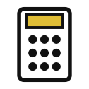




Words we use today
Word | What it means
Workflow map | A drawing of a task that repeats: one lane per person, a box per step, arrows for the order and the handoffs.
Rule-based automation | A machine follows fixed rules with no judgement, such as a bank standing order.
AI step | One judgement by a model inside a fixed path, such as a spam filter, checked by a person.
Baseline | How the task performs today, in time, cost and errors, measured before any change.
Payback period | How many months until the savings repay what you spent at the start.
Return on investment | What the first year gives back on top of what it cost, in shillings or as a percentage.
Notes:
6 words for today. I give the plain meaning of each, and we use every one of them before the end of the session.
Workflow map. A drawing of a task that repeats: one lane per person, a box per step, arrows for the order and the handoffs.
Rule-based automation. A machine follows fixed rules with no judgement, such as a bank standing order.
AI step. One judgement by a model inside a fixed path, such as a spam filter, checked by a person.
Baseline. How the task performs today, in time, cost and errors, measured before any change.
Payback period. How many months until the savings repay what you spent at the start.
Return on investment. What the first year gives back on top of what it cost, in shillings or as a percentage.
Keep those words close. The first idea uses them straight away, so let us begin.

Slide 7
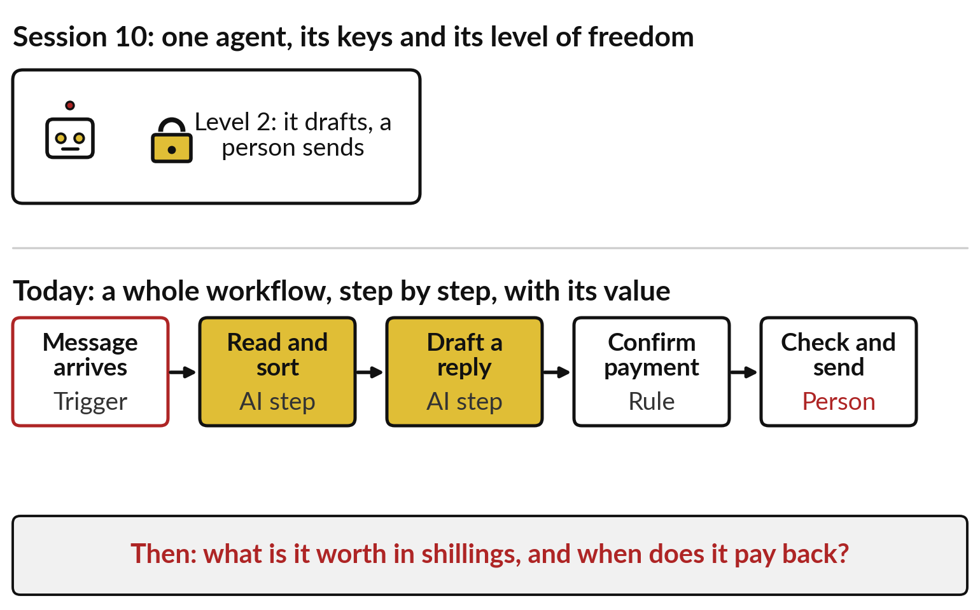
From Session 10 to today: from one agent
to a whole workflow, and what it is worth
Session 10 set what one agent may do. Today we redesign a whole task.
Each step gets a rule, an AI step, an agent or a person.
Then we put a value on it in shillings.
Notes:
Those six words carry today, and they build on Session 10. There we looked at one agent: its keys, its level of freedom, and who approves. A leader rarely buys one agent on its own. You change a piece of work that repeats, a workflow, and each step in it may need a different kind of help.
Look at the bottom row: one customer message travels through five steps, and only two of them use AI. One is a simple rule, and the last stays with a person. Today you draw a workflow like that from your own organisation, choose the help for each step, and then answer the question boards ask: what is it worth, and when does it pay back? First, why that question matters.

Slide 8
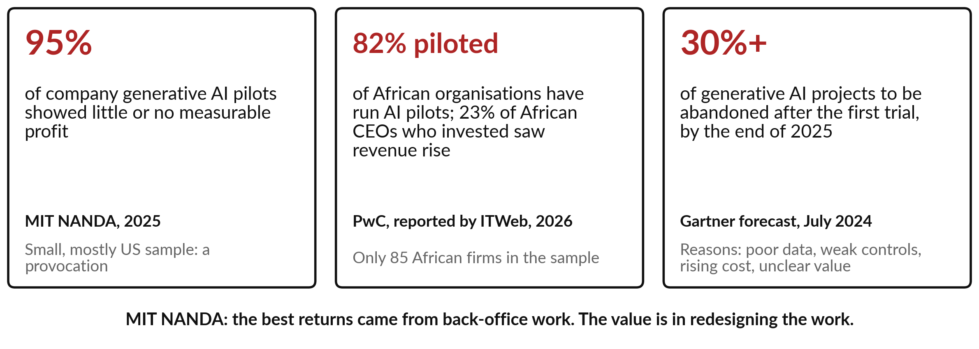
Most AI pilots show no profit; the ones that
pay redesign the work and count the money
Today’s question: which tasks change, what is it worth, and when does it pay back?
Notes:
Here is why it matters. In 2025 an MIT group called NANDA reported that about 95 per cent of company pilots of generative AI showed little or no measurable effect on profit. It was a small, mostly American sample, so treat it as a provocation. In Africa, PwC found in 2026 that 82 per cent of organisations had run AI pilots, yet only 23 per cent of African chief executives who invested saw revenue rise, again from a small sample.
And Gartner forecast in 2024 that at least 30 per cent of generative AI projects would be abandoned after the first trial, for poor data, weak controls, rising costs or unclear value. MIT found the best returns in back-office work. So today’s question is: which tasks change, what is it worth, and when does it pay back?

Slide 9
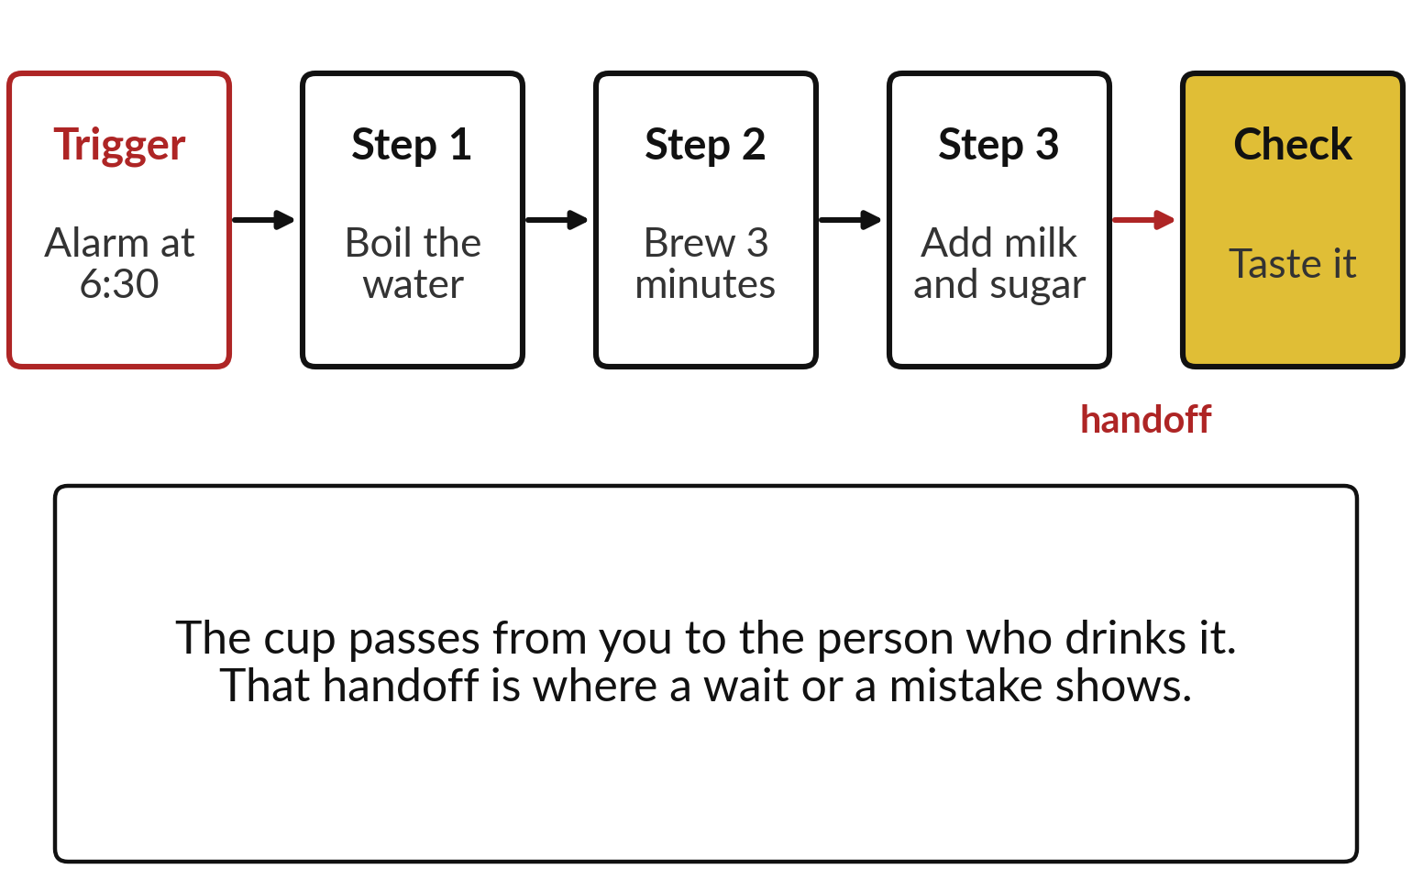
Everyday first: making tea is a workflow
with a trigger, steps, a handoff and a check
A workflow is a task that repeats. It has four parts.
Trigger: what starts it.
Steps: what is done, in order.
Handoff: where work changes hands.
Check: who confirms the result.
Notes:
To answer it we need one word, workflow, and we start with one you know: making morning tea. The trigger is the alarm at half past six. Then the steps, in order: boil the water, brew for three minutes, add milk and sugar. Then a handoff: the cup passes from you to the person who drinks it, so the work changes hands.
And the check: they taste it. If the tea arrives cold, the delay was probably at that handoff. Every workflow, at home or at work, has the same four parts: a trigger, steps, handoffs and a check. Drawing them makes the delays and the mistakes easy to see, so let me draw one at work.

Slide 10
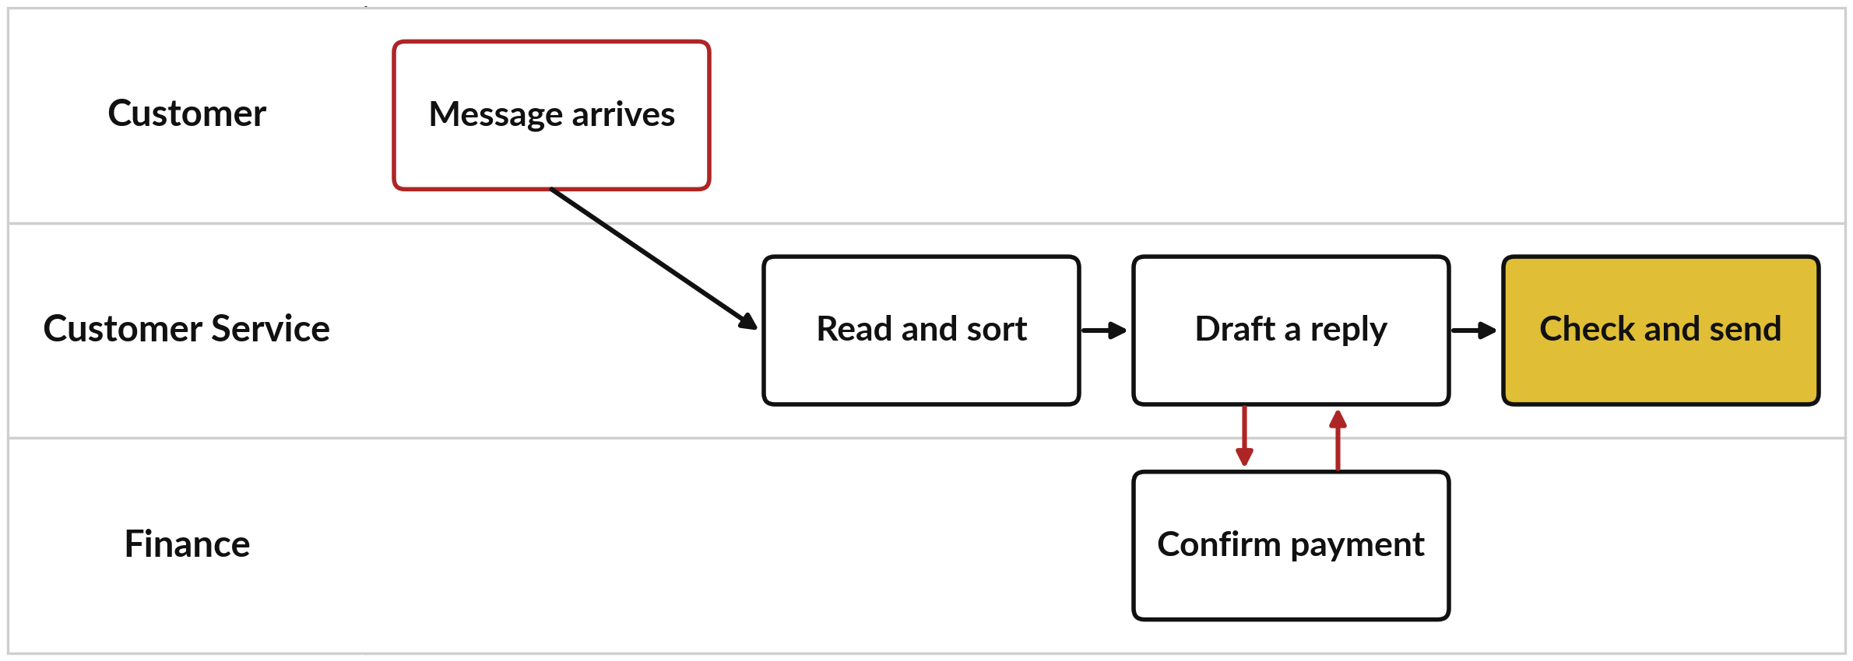
A workflow map: one lane for each person,
a box for each step, red arrows for handoffs
Customer messages at Nile Valley Foods (fictional): Customer Service waits for Finance.
Notes:
This is a workflow map from our fictional distributor, Nile Valley Foods. A customer message is a short text, such as an order, a payment notice or a complaint, and the company wants each one handled by the right team. Each person or team gets a lane, a row across the page: the customer, Customer Service and Finance.
Each step is a box in the lane of whoever does it, and arrows show the order. The trigger, with a red edge, is a message arriving. Customer Service reads and sorts it, then drafts a reply. When money is involved, the draft waits for Finance to confirm the payment: those red arrows are handoffs, where work waits.
Finally a person checks and sends. So who, or what, should do each box?

Slide 11
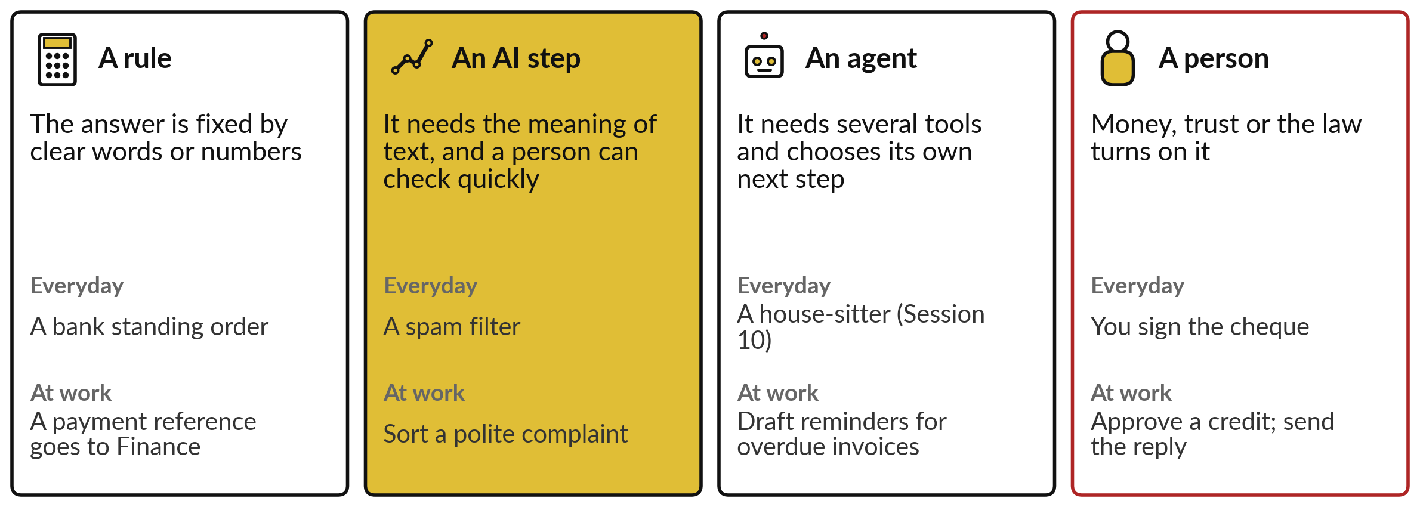
For each step choose one of four: a
rule, an AI step, an agent or a person
Ask in this order and take the first that fits: it is the simplest.
Notes:
There are four answers, and you know most of them already. A rule, which the industry calls rule-based automation, follows fixed instructions with no judgement, like a bank standing order; use it when the answer is fixed by clear words or numbers. An AI step is one judgement by a model inside a fixed path, like a spam filter; use it when the step needs the meaning of text and a person can check it quickly, as in Sessions 2 and 4.
An agent, from Session 10, uses several tools and chooses its next step. And a person decides wherever money, trust or the law turns on the step. Ask in that order, and take the first that fits, because it is the simplest and cheapest.

Slide 12
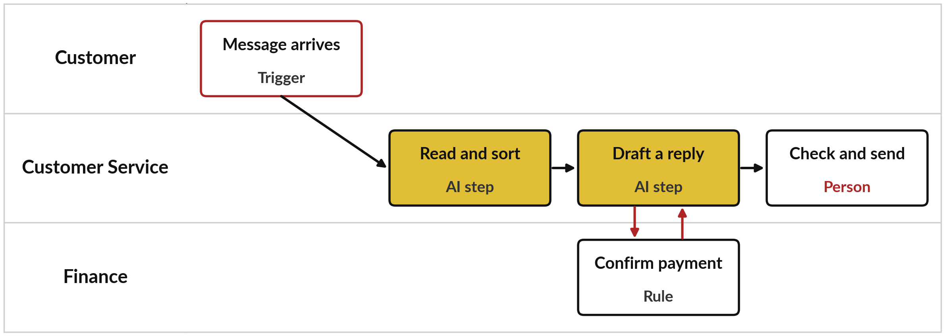
The same map with a choice on every
step: two AI steps, one rule and a person
No step here needs a full agent. Most workflows need one or two AI steps.
Notes:
Here is the same map with the four questions answered. Reading and sorting is an AI step, because meaning matters: a polite complaint has no angry words for a rule to catch. Drafting a reply is an AI step too, checked by a person. Confirming a payment is a rule, because a payment reference is clear.
Checking and sending stays with a person, because a reply commits the company: that is the human approval of Session 10. Notice that no step needs a full agent. Most workflows need one or two AI steps inside a fixed path, and an agent earns its place only when the steps change from case to case.
Once the map is decided, the next question is what the change is worth.

Slide 13
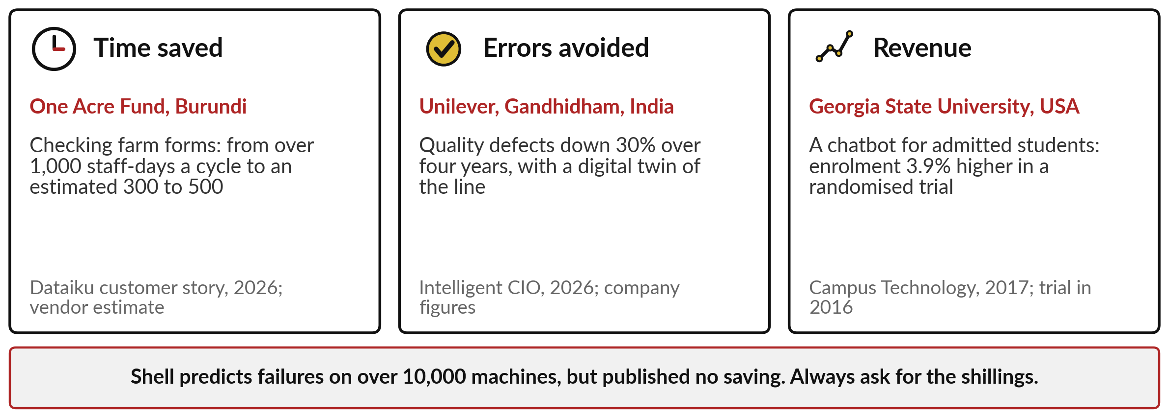
Value comes in three kinds: time
saved, errors avoided and revenue
Count each in shillings, and count each only once.
Notes:
Value comes in three kinds, and each has a real example. Time saved: at One Acre Fund in Burundi, software checks farm delivery forms and staff look only at the flagged entries; the vendor estimates the work fell from over 1,000 staff-days a cycle to between 300 and 500.
Errors avoided: at Unilever’s factory in Gandhidham, India, quality defects fell 30 per cent over four years with a live digital copy of the line. Revenue: at Georgia State University, a chatbot for admitted students raised enrolment by 3.9 per cent in a randomised trial in 2016. And a caution from Shell, which predicts failures on more than 10,000 machines but published no saving: always ask for the shillings. Now the tour.

Slide 14
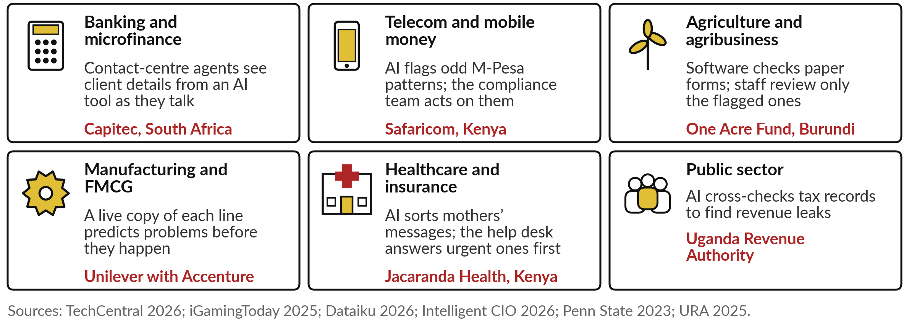
Redesigned workflows in six industries,
with one named example in each
Three stories follow: Coca-Cola, Unilever and the Uganda Revenue Authority.
Notes:
Here is a redesigned workflow in each of the six main industries. In banking, Capitec’s contact-centre agents see client details from an in-house AI tool while they talk. In mobile money, Safaricom’s models flag odd M-Pesa patterns, and its compliance team acts on the alerts. In agriculture, One Acre Fund’s software checks paper forms, and staff review only the flagged ones.
In manufacturing, Unilever runs a live copy of each production line that predicts problems. In health, Jacaranda Health’s AI sorts mothers’ messages so the help desk answers urgent ones first. And in the public sector, the Uganda Revenue Authority cross-checks tax records to find leaks. In every tile, a person still owns a step. Three stories follow.

Slide 15
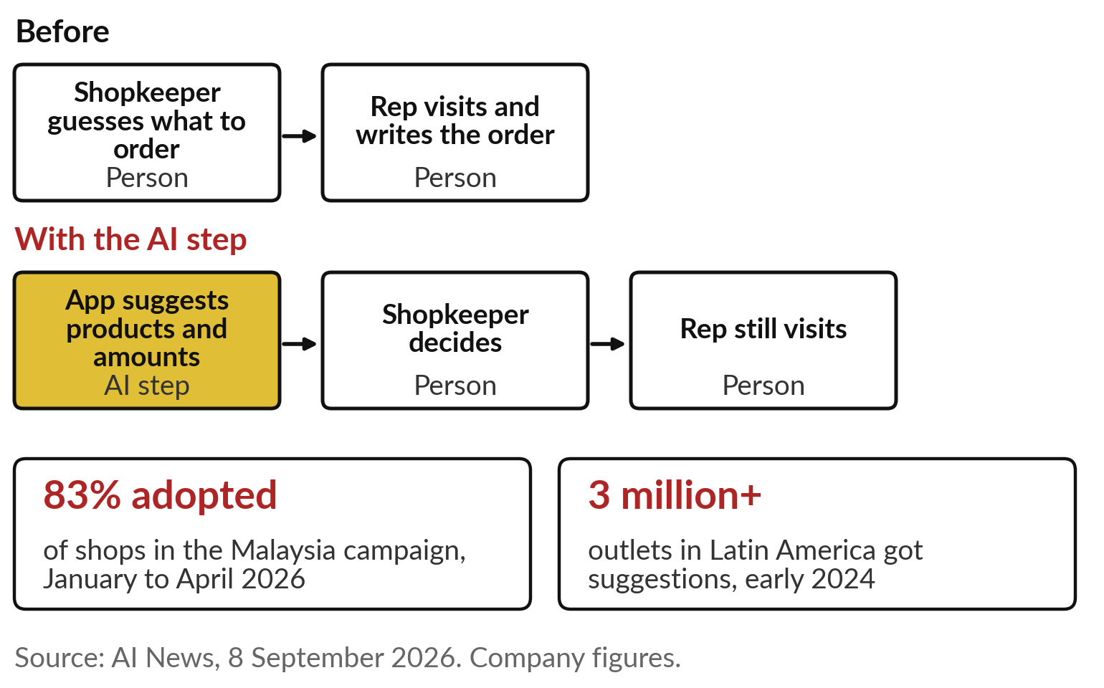
Coca-Cola: the app suggests the order, the
shopkeeper decides, and the rep still visits
Session 2 met this as a prediction. Today, look at who does each step.
The AI step suggests.
A person decides.
The sales rep still visits.
Notes:
The first story you met in Session 2 as a prediction. Today look at the workflow. Before, the shopkeeper guessed what to order and the sales rep visited to write it down. Now, when a shop orders on the bottler’s app or on WhatsApp, an AI step suggests which products and how many, from past orders, the season, the weather and similar shops.
The shopkeeper decides, and the sales reps still visit, alongside the app. In Malaysia, 83 per cent of the shops in the campaign adopted the suggestions between January and April 2026, and more than 3 million outlets in Latin America received them in early 2024. These are company figures, and no sales growth was disclosed for Malaysia, so the business case is still open.

Slide 16
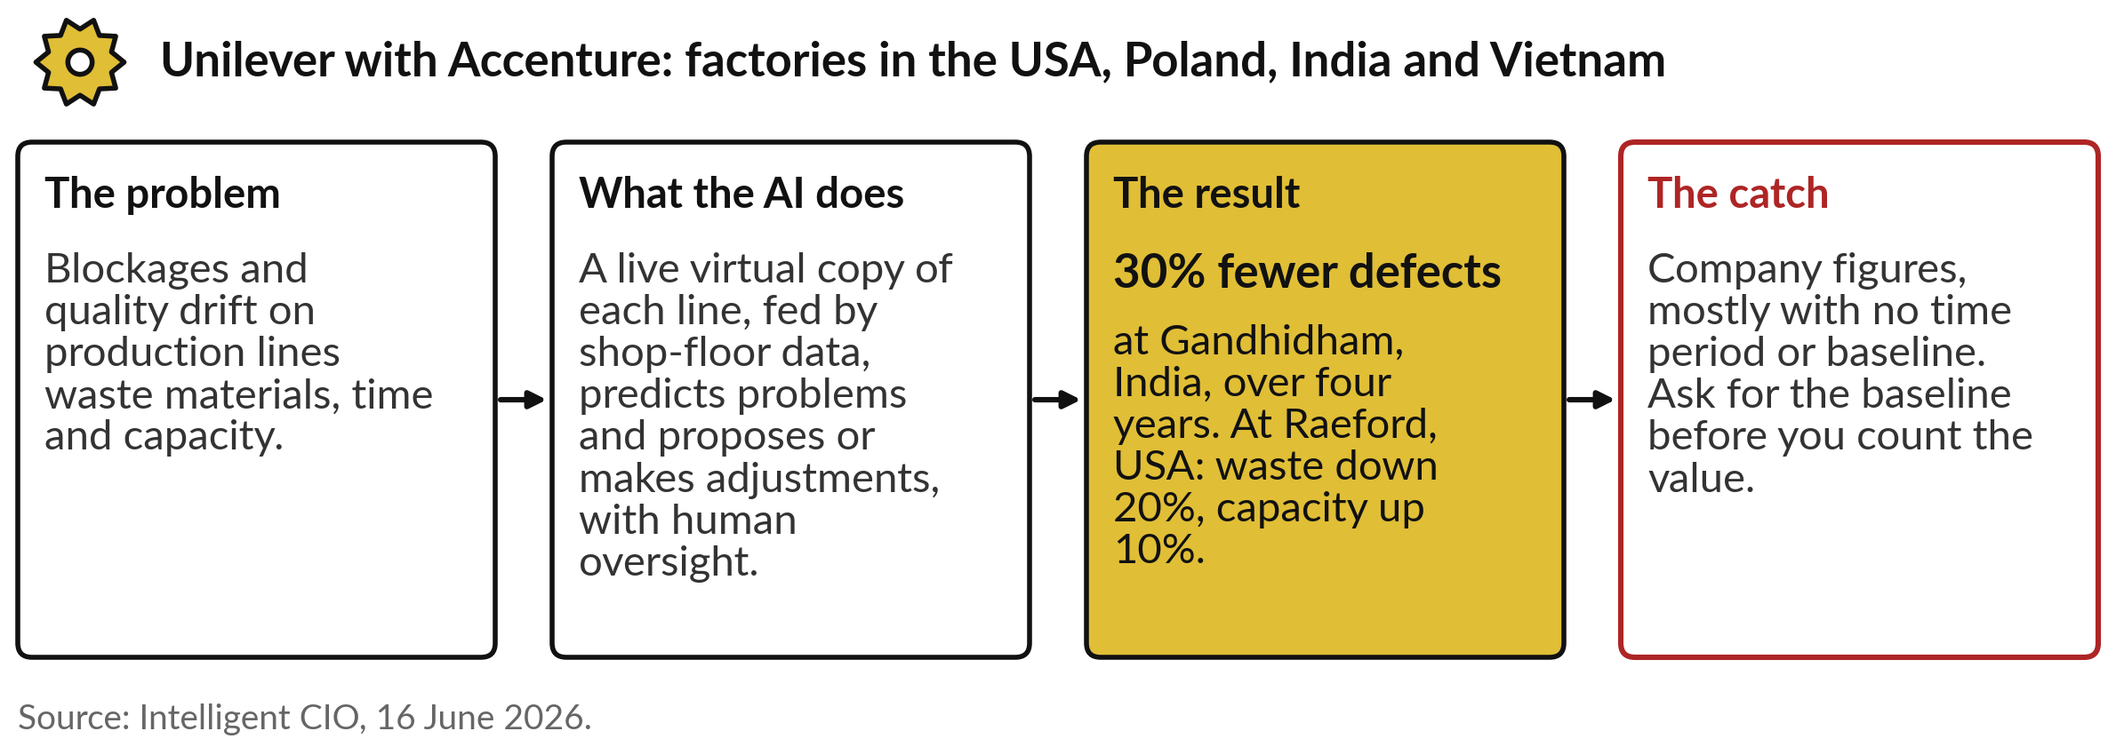
Unilever: a live copy of each factory line
predicts problems, with people overseeing
The industry calls such a live copy a digital twin.
Notes:
The second story is manufacturing. On a production line, blockages and quality drift waste materials, time and capacity. Unilever, working with Accenture, builds a live virtual copy of each line, fed by data from the shop floor, which the industry calls a digital twin. It predicts problems such as blockages, and proposes or makes adjustments, acting on its own only with human oversight.
At Gandhidham in India, quality defects fell 30 per cent over four years. At Raeford in the United States, waste fell 20 per cent and capacity rose 10 per cent. Unilever plans more than 40 new twins. The catch: these are company figures, mostly with no time period or baseline, so ask for the baseline before you count the value.

Slide 17
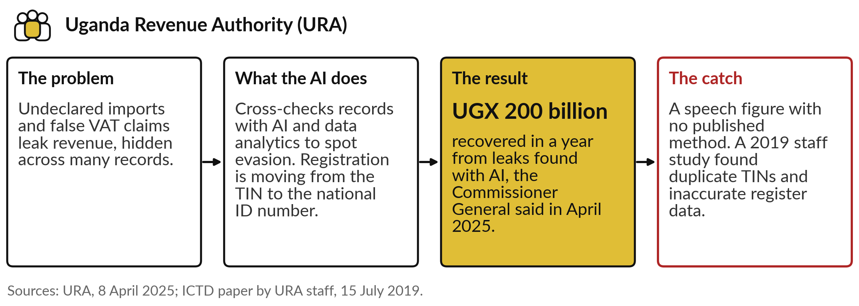
Uganda Revenue Authority: AI finds revenue
leaks, on a register that needed cleaning
The value depends on clean data: Session 14 returns to it.
Notes:
The third story is from home, and you met its headline figure in Session 0. Undeclared imports and false VAT claims leak revenue, and the evidence hides across many records. The Uganda Revenue Authority uses AI and data analytics to cross-check those records and spot evasion, and it is moving taxpayer registration from the TIN to the national ID number.
In April 2025 the Commissioner General said that in the previous year URA recovered 200 billion shillings in revenue leakages uncovered through AI. The catch, as in Session 0: it is a speech figure, with no published method or audit. And a 2019 study by URA’s own staff found inaccurate data in the taxpayer register, such as people holding several TINs.
The value of a redesigned workflow depends on clean data, which Session 14 takes up.

Slide 18
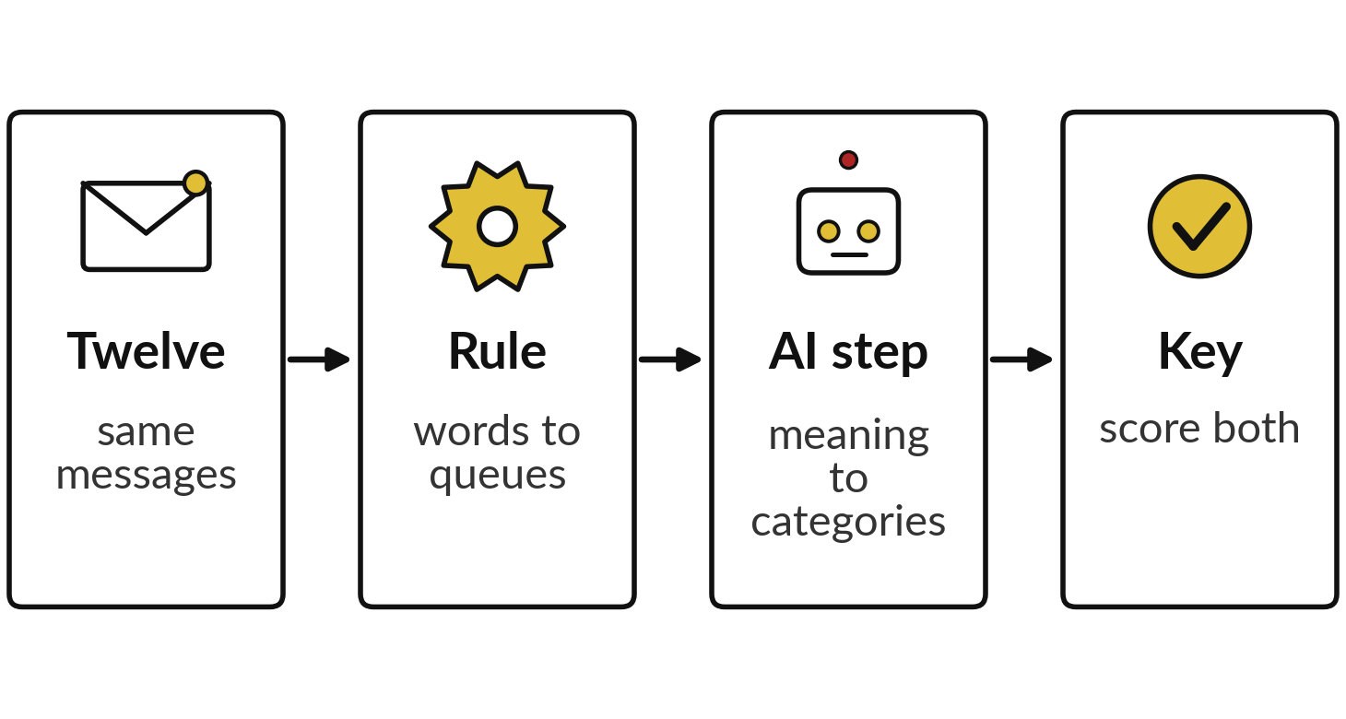
Worked example: the rule and the AI
on the same twelve customer messages
I will show
Watch for
Which messages fool the rule?
Which one fools the AI?
What does UNSURE cost you?
What was never measured?
Notes:
Before we put money on a change, test the cheapest options on real messages. You saw these twelve messages in Session 0, where a rule and a chatbot sorted them. Today we read the same recorded result as a business decision; nothing is rerun. Twelve customer messages from the Nile Valley Foods practice file were scored against an answer key written before anything ran.
The rule is a keyword router written after reading the messages, which flatters it: payment words go to Finance, late or delay to Customer Service, the rest to the Sales desk. The AI step read the meaning and picked a category, or said UNSURE. It ran in three fresh Claude sessions on 4 November 2026; it is not ChatGPT or Gemini.
Watch which messages fool each one, what UNSURE costs you, and what was never measured.

Slide 19
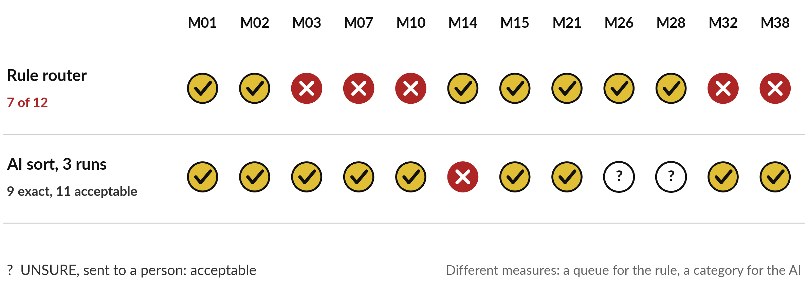
The rule routed 7 of 12 correctly; the
AI sorted 9 exactly and 11 acceptably
AI: Claude, three fresh sessions, 4 November 2026. Rule: computed. Different measures.
Notes:
So which messages fooled each one?
The rule sent seven of twelve to the right queue. It failed on wet sugar with no keyword, on a polite complaint, on sarcastic thanks, and on two orders where the word late was ordinary. The AI got nine exactly right. Two more it marked UNSURE and passed to a person, which we count as acceptable, so eleven of twelve were acceptable.
It was wrong on one, a payment message that was also a complaint, where Finance must act first. The two counts use different measures, a queue and a category, and the time a person takes to check was never measured. So the test tells you which kind of help fits. Next, what that help is worth.

Slide 20
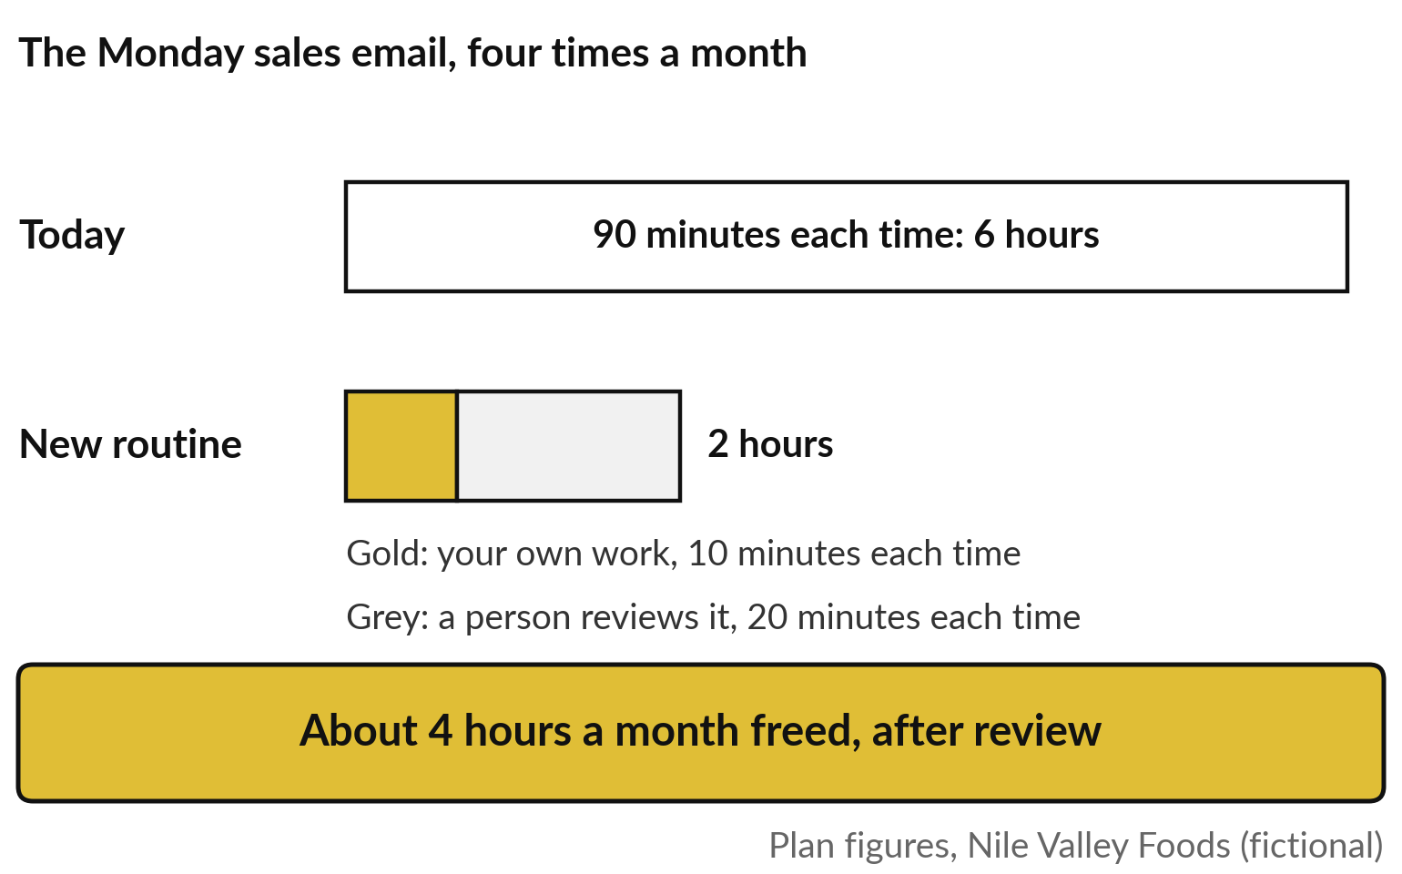
At work the first saving is usually time:
about 4 hours a month on one weekly email
The Monday sales email at Nile Valley Foods: plan figures.
Today: 90 minutes, four times a month.
New routine: 10 minutes plus 20 of review.
Review time is real, so it is counted.
Notes:
Here is the business case worked in words, on one task: the Monday sales email at Nile Valley Foods, a weekly summary of sales for the managers. First the baseline, the industry’s word for how the task performs today, measured before any change. It takes 90 minutes, four times a month: six hours.
With the new routine, the manager spends 10 minutes of their own work, and a person reviews the draft for 20 minutes. That is two hours a month. So about four hours a month are freed, after review. These are plan figures from the Business Case Workbook example, invented for a fictional company. Hours persuade you, but whoever holds the budget wants shillings.

Slide 21
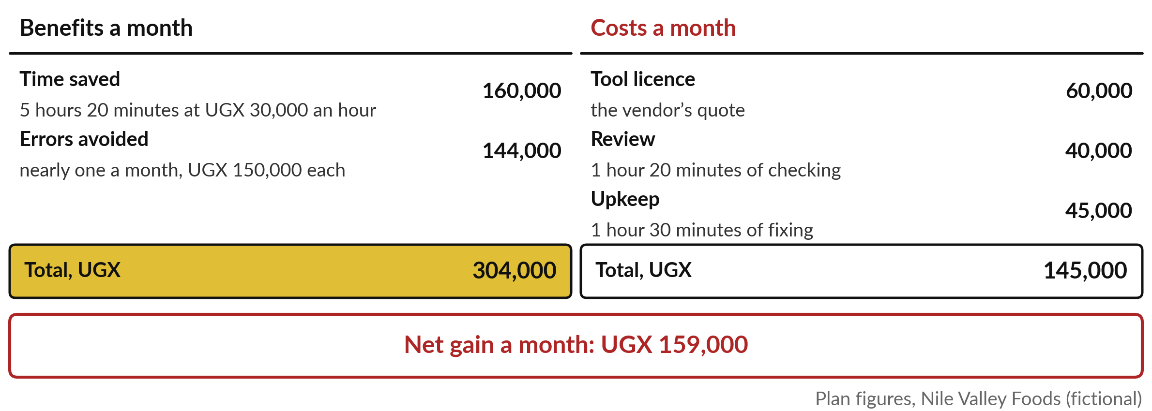
In shillings: UGX 304,000 of benefit
and UGX 145,000 of cost each month
Review is priced as a cost, never treated as free.
Notes:
The workbook turns the hours into shillings. One staff hour at Nile Valley Foods costs about UGX 30,000, pay plus employer contributions. On the benefit side, the manager saves five hours and twenty minutes a month of building the email, worth UGX 160,000; the review time comes back below as a cost, which is why the last slide said about four hours.
Today four emails in ten contain an error, and the plan expects the new routine to remove six in ten of them, which avoids nearly one error a month, each costing UGX 150,000 to fix: UGX 144,000. Together, UGX 304,000. On the cost side: the tool licence the vendor quoted, UGX 60,000; review time, UGX 40,000; and upkeep, UGX 45,000; together UGX 145,000.
So the net gain is UGX 159,000 a month, all plan figures.

Slide 22
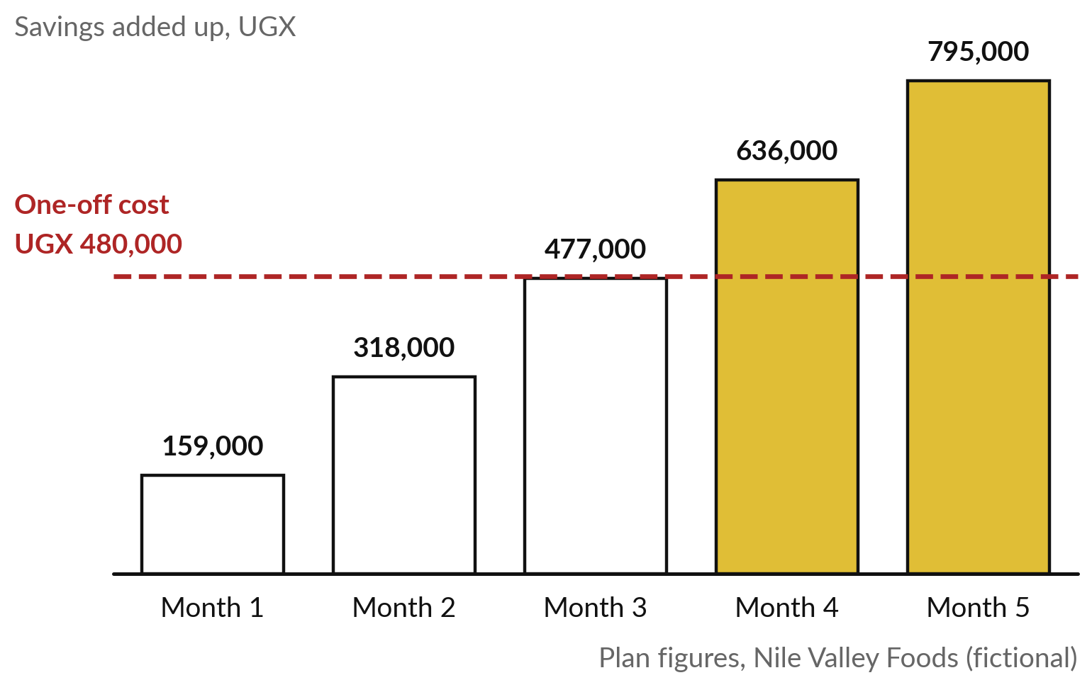
Payback: the UGX 480,000 spent at
the start is repaid just after month 3
Add the monthly gain until it covers the one-off cost.
One-off: 12 hours of set-up, 4 of training.
After month 3: UGX 477,000 back.
Payback period: about 3 months.
Notes:
Before any of that monthly gain arrives, you spend once. Here the one-off cost is sixteen hours of staff time, twelve to set up and prepare the data and four to train people, at UGX 30,000 an hour: UGX 480,000. Now add up the net gain month by month.
After month one, UGX 159,000 is back. After month two, 318,000. After month three, 477,000, just short of the 480,000. Early in month four the change has paid for itself. The industry calls this the payback period, and here it is about three months. A shorter payback means the money comes back sooner and the risk is smaller.
And what does the whole first year give?

Slide 23
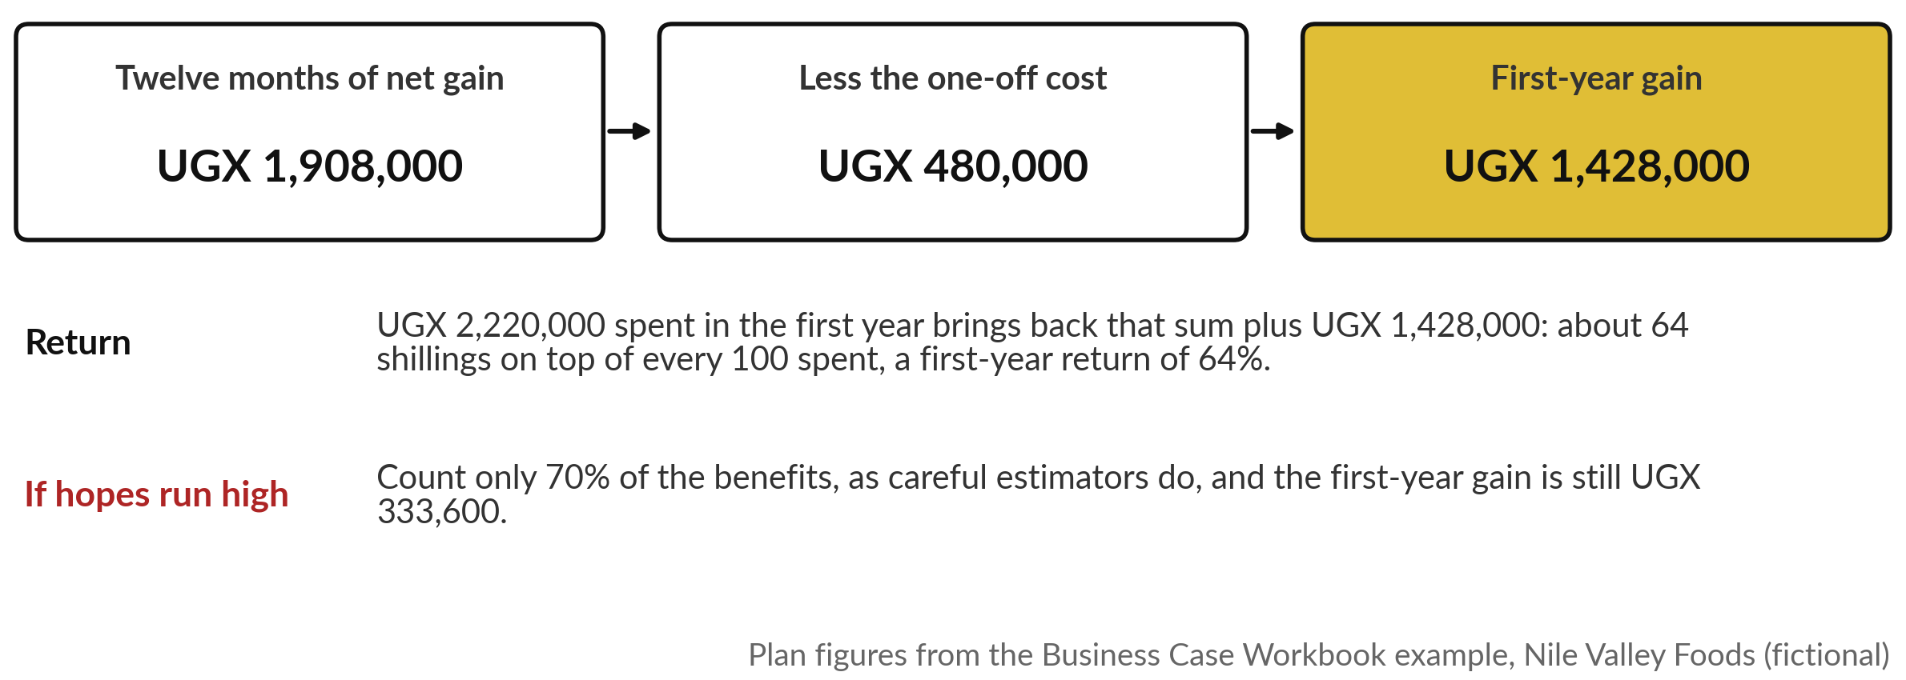
The first year: UGX 1,428,000 ahead, a return
of about 64%, and still positive if hopes run high
The workbook calls the 30% cut a haircut. A case that survives it is stronger.
Notes:
Over the first year, twelve months of net gain come to UGX 1,908,000. Take away the one-off cost of UGX 480,000 and the first-year gain is UGX 1,428,000. In that year the company spends UGX 2,220,000 in all, the one-off cost plus twelve months of running costs, and gets back that sum plus the gain: about 64 shillings on top of every 100 spent.
The industry calls this the return on investment, here 64 per cent for the first year. Estimates are usually too hopeful, so the workbook also counts only 70 per cent of the benefits, a cut it calls a haircut. The first-year gain is then UGX 333,600, smaller but still positive.
So how do we choose among many such cases?

Slide 24
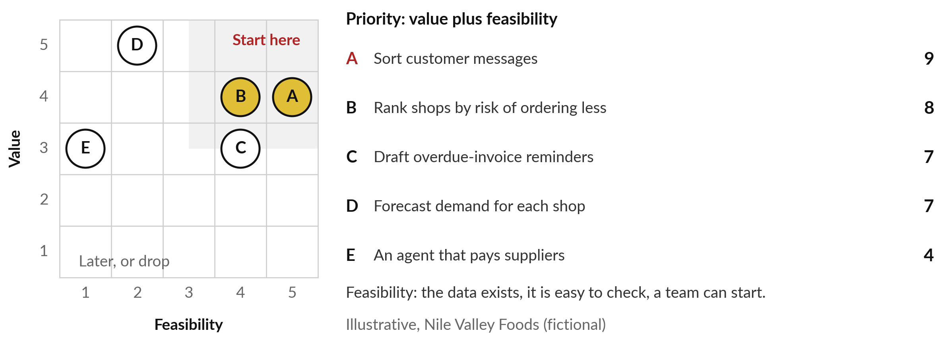
Score your portfolio: value and
feasibility, 1 to 5 each, and start top right
Start with the highest priority that is also cheap to get wrong.
Notes:
Your portfolio already holds many ideas, and you cannot build a full case for each, so you need a quick way to choose. The AI Opportunity Portfolio has a Score sheet. Give each entry two scores from 1 to 5. Value: 5 saves a lot of time or money, or matters a lot to customers.
Feasibility: 5 means the data exists, the result is easy to check, and a team can start now. The priority is the two added, at most 10. Here are five illustrative entries for Nile Valley Foods. Sorting customer messages scores 9 and sits top right: start there. Forecasting demand for every shop is valuable but hard, so prepare first.
An agent that pays suppliers comes last. After the break, you do this yourself.

Slide 25
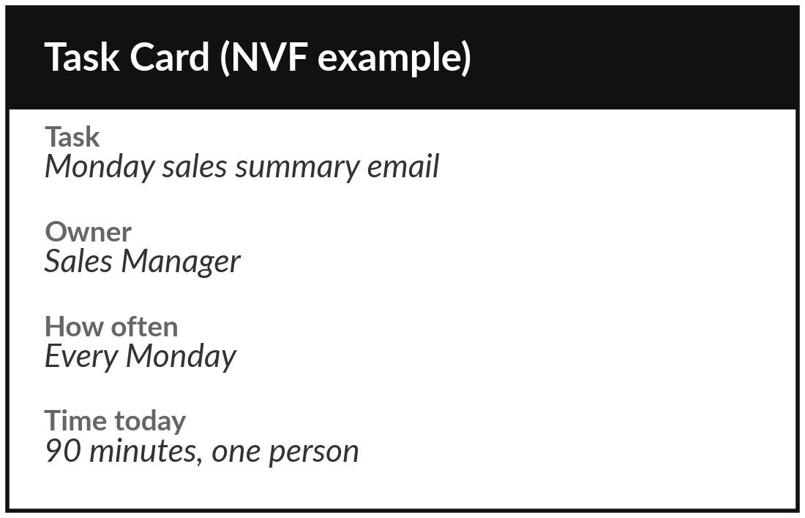
Map one workflow of your own:
trigger, steps, handoffs and check
15 minutes
Your own workflow
Draw one task your team repeats every week, in lanes.
Pick one weekly task, and fill the top of a Task Card.
Draw a lane for each person or system.
Write the trigger, then each step in a box.
Mark handoffs in red and the check in gold.
You keep: A one-page map with its handoffs marked.
Notes:
Welcome back. From here to the decision the work is yours, and I am at your side. Pick one task your team repeats every week: the monthly report, supplier invoices, leave requests, customer messages or loan applications. If you cannot choose, list a few on the Use-Case Scorecard and pick the one that costs the most time.
Fill the top of a Task Card: the task, the owner, how often and the time it takes today. Then draw it as we drew the tea and the messages: a lane for each person or system, the trigger, each step in a box, handoffs in red and the check in gold.
You have fifteen minutes, and I come round to ask where the work waits.

Slide 26
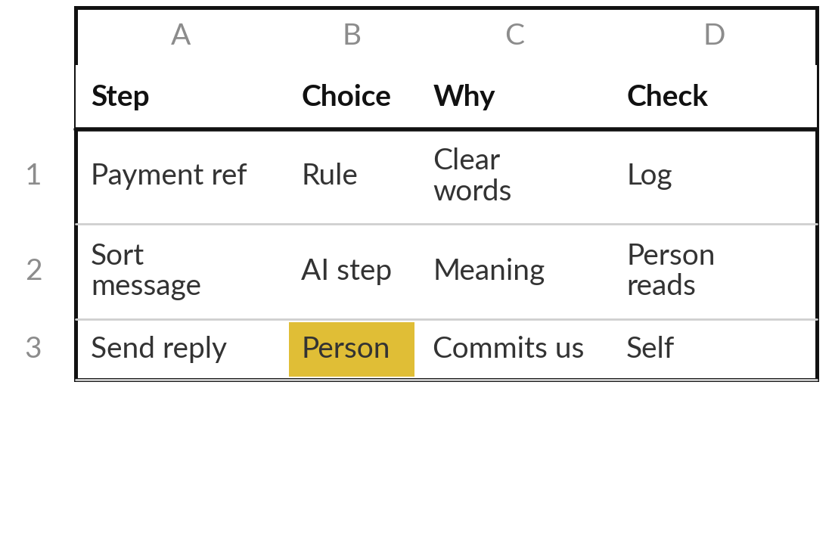
Choose for each step: a rule, an
AI step, an agent or a person
10 minutes
Your own workflow
Write one choice and one reason in every box.
Ask the four questions in order.
Write rule, AI step, agent or person.
For each AI step, write how a person checks it.
Give any agent its level of freedom.
You keep: Your map with a choice, a reason and a check on every step.
Notes:
With your map drawn, the second step is to decide, using the four choices from earlier. For every box, ask in order. Is the answer fixed by clear words or numbers?
A rule. Does it need meaning, with a quick check?
An AI step. Does it need several tools and its own next step?
An agent, with the level of freedom you would set in Session 10. Does money, trust or the law turn on it?
A person. Write the choice and one reason in the box. For every AI step, write how a person checks it, because Session 9 showed us how AI fails. Then circle the step that costs the most time. You have ten minutes.

Slide 27
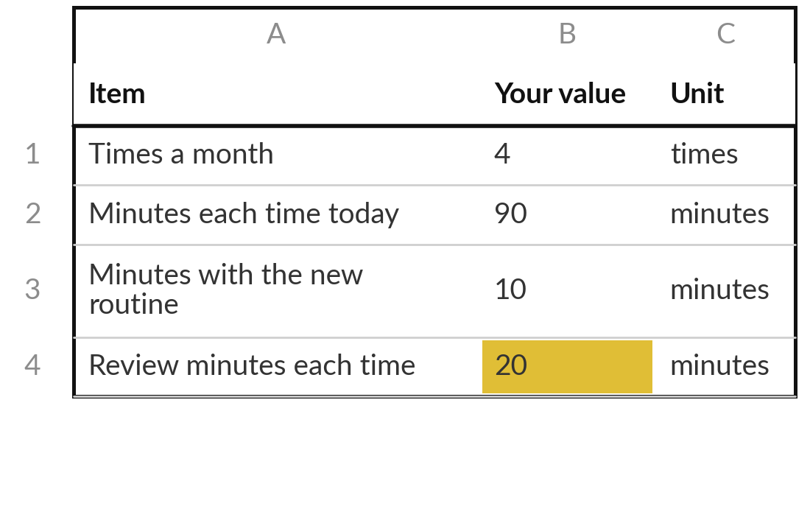
Put a value on it in the Business Case Workbook
20 minutes
Your own workflow
Fill the Inputs sheet and read the payback and the first-year gain.
Enter how often and the minutes today: your baseline.
Enter minutes with the new routine and for review.
Enter your hourly cost and the cost of one error.
Mark each figure E for estimate or M for measured.
You keep: Your Inputs sheet, with the payback and the first-year gain.
Notes:
Now the circled step gets its business case, in twenty minutes. Open the Business Case Workbook at the Inputs sheet and type over the grey Nile Valley Foods example. Enter how often the task runs and the minutes it takes today: that is your baseline. Then the minutes with the new routine and the minutes a person spends reviewing; never set review to zero.
Add your hourly cost, pay plus contributions divided by hours worked, and the cost of one error. Mark every figure E if it is your estimate and M if you measured it. The Result sheet then shows the net gain a month, the payback period and the first-year gain, before and after the haircut. I come round to check your figures with you.

Slide 28
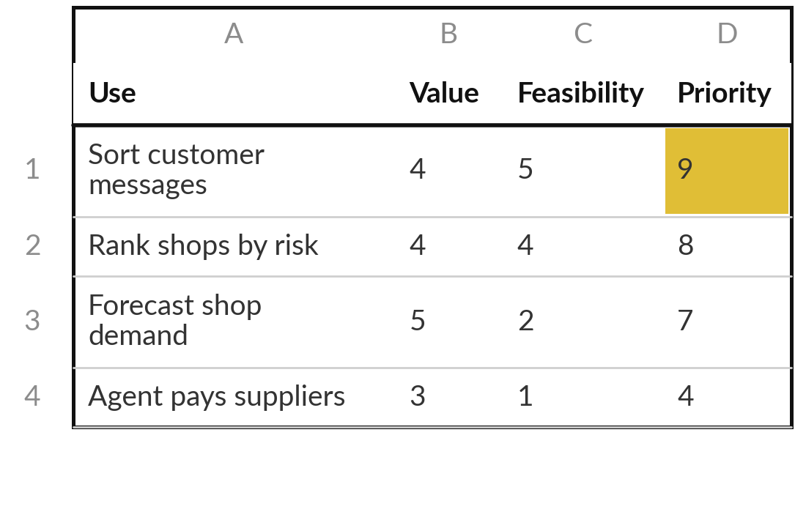
Score your portfolio on value
and feasibility, and rank it
15 minutes
Your own portfolio
Give every portfolio entry a value and a feasibility score.
Open the Score sheet of your portfolio.
Score value and feasibility, 1 to 5.
Write why, in one line.
Circle the top entry that is cheap to get wrong.
You keep: A ranked portfolio with your first candidate circled.
Notes:
The last fifteen minutes turn your whole portfolio into a ranking. Open the Score sheet of the AI Opportunity Portfolio; it pulls in every entry you have written since Session 0. Give each one a value score and a feasibility score from 1 to 5, and write one line on why.
The sheet adds the two and ranks them. Use what today taught you: an entry with a mapped workflow and a business case can be scored with confidence, while the others are a first view. Then circle the highest-ranked entry that is also cheap to get wrong. That entry is your candidate for a first pilot, and Sessions 12 to 14 add its people, its risks and its data.

Slide 29
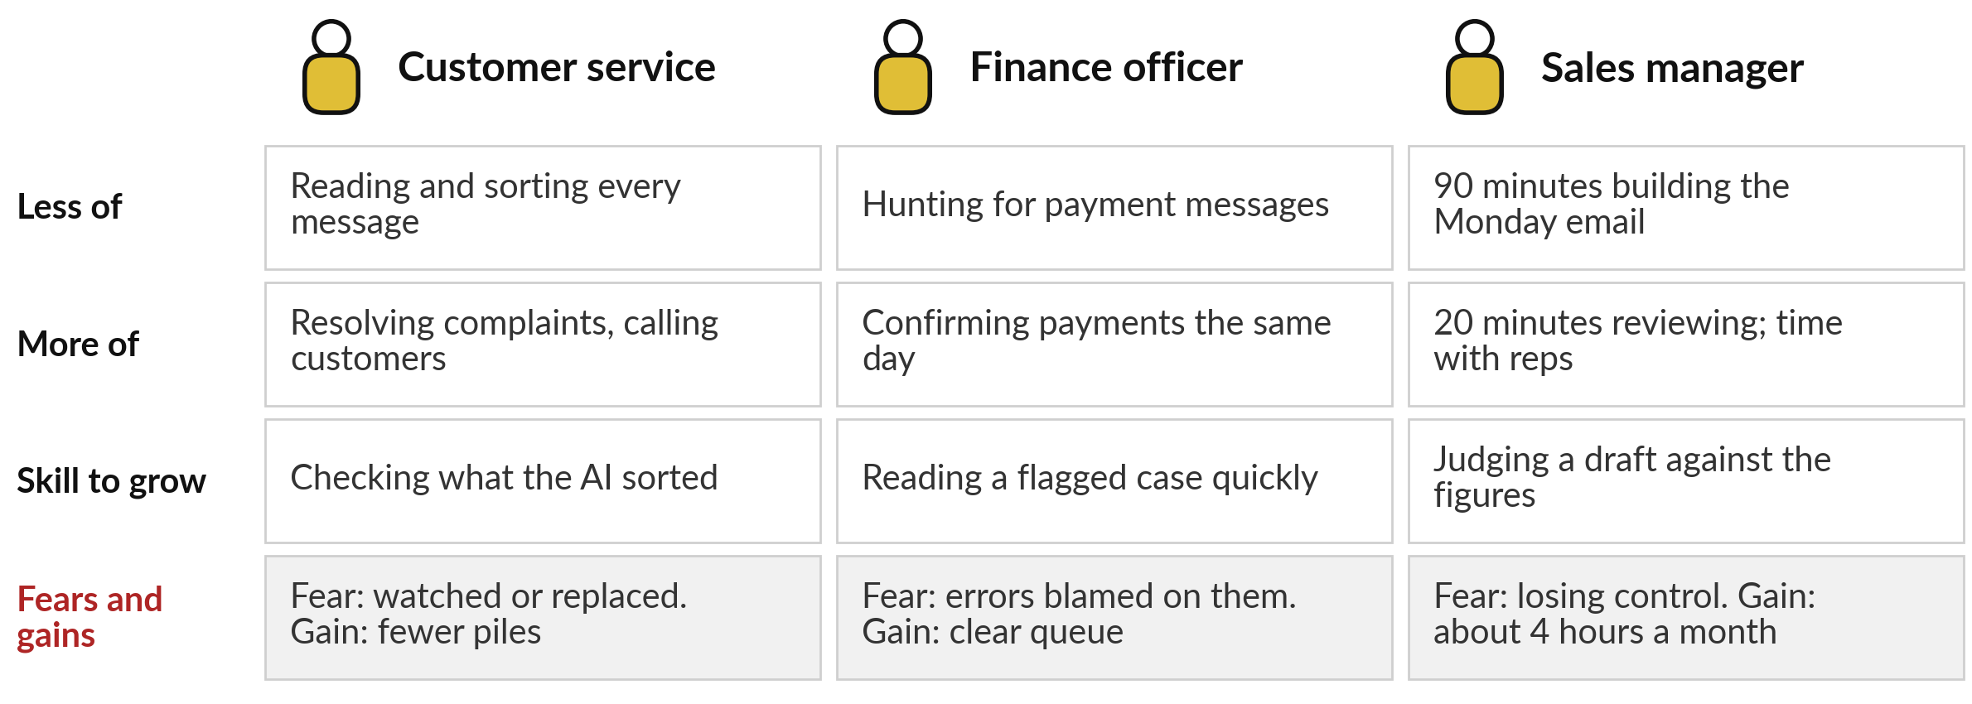
Your people: each redesigned workflow
moves hours from routine work to judgement
MIT NANDA: firms tended not to refill support roles, rather than lay people off.
Notes:
Before you decide, look at who your map touches, because Session 12 is about them. On our message workflow, the customer service officer reads and sorts less, and spends more time resolving complaints and calling customers; the new skill is checking what the AI sorted. The finance officer stops hunting for payment messages and confirms payments the same day.
The sales manager spends 20 minutes reviewing the Monday email in place of 90 building it, so about four hours a month move to time with the reps. Each fears something: being watched, being blamed, losing control. MIT’s researchers found firms tending not to refill support roles, rather than laying people off. Write the roles and the hours on your map.

Slide 30




Plan against measurement: four
numbers to record for four weeks
Minutes each run with the new routine, review included.
Errors found in each run, and what each cost.
Cases sent to a person, such as UNSURE.
Your stop rule: the number at which you revise or stop.
Notes:
Most figures in your workbook are marked E, so your case is a plan. Before anyone spends money, run the new routine for four weeks and record four numbers, so the estimates become measurements. Minutes each run, review included. Errors found in each run, and what each one cost.
Cases sent to a person, such as the UNSURE answers we saw from the AI. And your stop rule, written now while you are calm: for example, revise if review rises above thirty minutes a run. The workbook’s Stop rules sheet has examples. A measured result that beats the plan is the strongest case you can take to your board. With that, you are ready to decide.

Slide 31
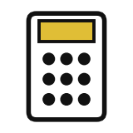



Which entry goes to a pilot first,
and with which kind of help?
For your top entry, what is your first step?
A rule first
One AI step
An agent at level 2
Measure first
Clear words or numbers: automate it without AI. Cheap and easy to explain.
Meaning matters, and a person checks each result.
Several steps; it drafts and a person approves.
No baseline yet: time four weeks, then decide.
Write the entry, your choice, its payback and the number that will show it worked.
Notes:
Your map, your choices, your business case and your ranked portfolio are on the desk, so decide. For your top entry, what is your first step?
A rule first, when the words or numbers are clear: cheap, fast and easy to explain, with no AI needed. One AI step, when meaning matters and a person checks each result. An agent at level two, when several steps change from case to case: it drafts and a person approves.
Or measure first, when you have no baseline yet, which is a sound choice for most leaders today. Say your choice aloud, then write the entry, the choice, its payback and the number that will show it worked.

Slide 32
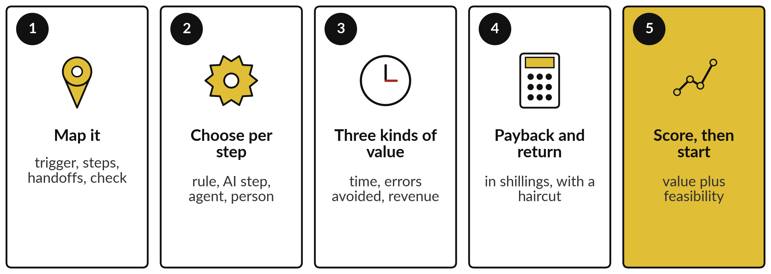
Take-away: five things to remember
Notes:
Here is the session in five lines. Map the work before you buy anything: trigger, steps, handoffs and the check. Choose the simplest help for each step: a rule, an AI step, an agent or a person. Count value in three kinds, time saved, errors avoided and revenue, each in shillings and only once.
Work out the payback and the first-year return, and test them with a haircut. And score your portfolio on value and feasibility to choose where to start. Our worked example paid back in about three months, with a first-year gain of UGX 1,428,000, all plan figures still to be measured. Now, what you take away.

Slide 33
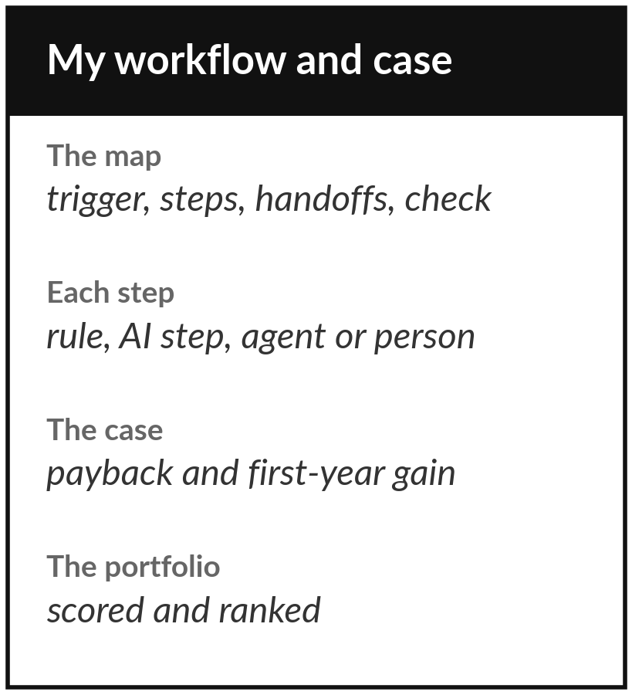
Keep your map, your business
case and your ranked portfolio
What you keep from today
Your mapped workflow with a choice on every step, your Business Case Workbook with the payback and the first-year gain, and your portfolio scored on value and feasibility.
Our question today
Which tasks change, what is it worth, and when does it pay back?
Next session
Session 12: Leading people through AI: roles, skills, adoption and change. Bring your map and the roles it touches.
Notes:
Your decision closes the practical work for today. You keep your map with a choice on every step, your Business Case Workbook with the payback and the first-year gain, and your portfolio scored and ranked. Remember that most of your figures are estimates: measure four weeks before you trust them.
Session 12 turns to the people whose work your map changes: their roles, their skills, their fears, and how you bring them with you. Bring your map and the roles you wrote on it.
We began with this question: Which tasks change, what is it worth, and when does it pay back? Before you go, say in one sentence what you can now say about it.

